Slide 1

Rights and Freedoms - Union N.L.E.
Monitoring of Teacher Trainings in Georgia
July-August 2011
Prehistory
Training Timetable Scheduling
Photo Report from Trainings
Training Evaluation Research Results

Slide 2
Rights and Freedoms - Union N.L.E.
Monitoring of Teacher Trainings in Georgia
Prehistory

Slide 3
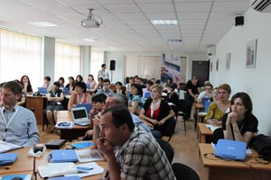
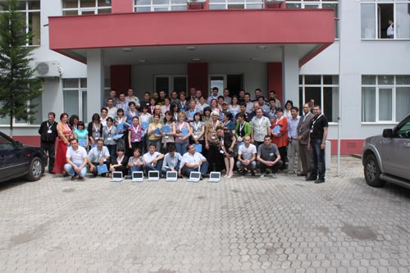
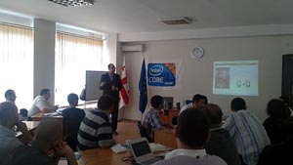
Rights and Freedoms - Union N.L.E.
Monitoring of Teacher Trainings in Georgia
42 Master teachers and 29 IT admins were trained in Kutaisi, Georgia. May 13-15, 2011

Slide 4
Rights and Freedoms - Union N.L.E.
Monitoring of Teacher Trainings in Georgia
Training Timetable Scheduling

Slide 5
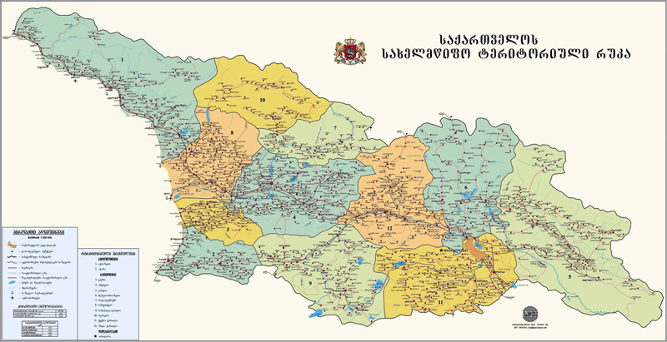
Rights and Freedoms - Union N.L.E.
Monitoring of Teacher Trainings in Georgia
From July’11 till September’11 were trained 3637 teachers in 40 regional centers

Slide 6
Rights and Freedoms - Union N.L.E.
Monitoring of Teacher Trainings in Georgia
Training Timetable Scheduling
Master Trainer | Region | Groups | Teachers per group | Total
Shorena Mikaberidze | Bolnisi | 4 | 13 | 52
 | Tetritskaro | 3 | 12 | 36
 | Rustavi | 2 | 13 | 26
Manana Kapanadze | Khashuri | 4 | 13 | 52
 | Kharagauli | 3 | 14 | 42
Irina Markozashvili | Tbilisi | 6 | 12 | 72
 | Marneuli | 2 | 14 | 28
Zaza Mokhvashi | Tbilisi | 8 | 13 | 104
Rusudan Markozashvili | Tbilisi | 8 | 13 | 104
Maia Bazgadze | Tbilisi | 8 | 14 | 112
Teona Lotikashvili | Tbilisi | 8 | 13 | 104
Diana Miqadze | Tbilisi | 8 | 13 | 104
Natia Mumladze | Tbilisi | 5 | 13 | 65
Inga Kakhiani | Imereti | 10 | 13 | 130
Megi Kapanadze | Imereti | 10 | 13 | 130
Mari Marchiladze | Imereti | 10 | 14 | 140
Nodar Tsagareishvili | Imereti | 10 | 13 | 130
Gogita Mokhvashi | Samegrelo | 10 | 13 | 130
Nona Qadaia | Samegrelo | 7 | 14 | 98
Eka Samurkasovi | Poti | 7 | 12 | 84

Slide 7
Rights and Freedoms - Union N.L.E.
Monitoring of Teacher Trainings in Georgia
Training timetable scheduling
Master Trainer | Region | Groups | Teachers per group | Total
Levan Tsulaia | Samegrelo | 8 | 13 | 104
Lia Navrozashvili | Gardabani | 9 | 14 | 126
Marekhi Jeladze | Rustavi | 6 | 13 | 78
 | Svaneti | 3 | 11 | 33
Lili Zoidze | Tsalka | 3 | 14 | 42
 | Gardabani | 3 | 13 | 39
 | Dmanisi | 3 | 13 | 39
Marine Chitadze | Gori | 5 | 14 | 70
 | TianeTi | 2 | 9 | 18
Nino Mgebrishvili | Gori | 2 | 12 | 24
 | Dusheti | 4 | 13 | 52
Nana Edisherashvili | Gori | 6 | 14 | 84
Elene BeTlemishvili | Gori | 2 | 13 | 26
 | Mtskheta | 3 | 12 | 36
 | Kazbegi | 1 | 10 | 10
Natia Tsintsadze | QobuleTi | 4 | 12 | 48
 | Batumi | 5 | 13 | 65
Khatuna Lortkifanidze | Khelvachauri | 8 | 13 | 104
Zurab Kekelidze | Khulo | 6 | 13 | 78
 | Qeda | 2 | 13 | 26
Tengiz Gatenadze | Qeda | 4 | 12 | 48
 | Suakhevi | 5 | 14 | 70

Slide 8
Rights and Freedoms - Union N.L.E.
Monitoring of Teacher Trainings in Georgia
Training timetable scheduling
Master Trainer | Region | Groups | Teachers per group | Total
Maka Aframishvili | Axaltsikhe | 2 | 13 | 26
 | Akhalqalaqi | 3 | 14 | 42
 | Aspindza | 3 | 12 | 36
Nino Kokilashvili | Kakheti | 7 | 14 | 98
Qetevan Inanishvili | Signagi | 4 | 14 | 56
Khatuna Markozashvili | Akhmeta | 3 | 13 | 39
 | Tsageri | 2 | 14 | 28
 | Kakheti | 2 | 11 | 22
Zurab Dzuliashvili | Telavi | 4 | 11 | 44
 | OzurgeTi | 2 | 13 | 26
Dimitri Popovi | Gurjaani | 3 | 13 | 39
 | Svaneti | 3 | 14 | 42
 | Ninotsminda | 3 | 14 | 42
Marekhi Natenadze | Akhalqalaqi | 4 | 14 | 56
 | Adigeni | 2 | 13 | 26
 | Borjomi | 2 | 13 | 26
 | Akhaltsixe | 2 | 13 | 26

Slide 9
Rights and Freedoms - Union N.L.E.
Monitoring of Teacher Trainings in Georgia
Photo Report from Trainings

Slide 10
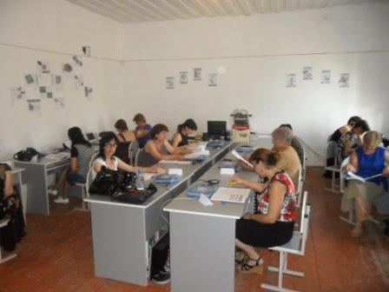
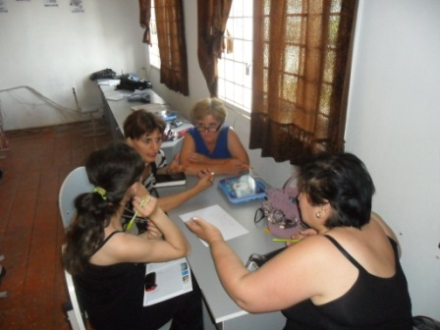
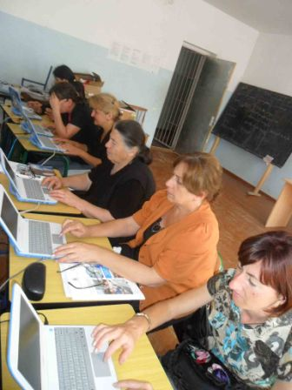
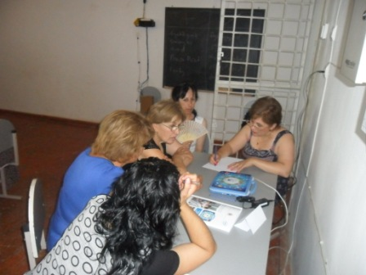
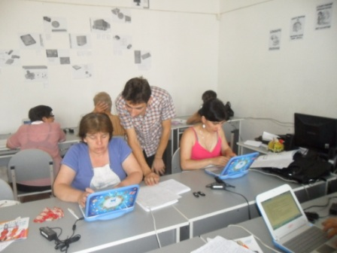
Rights and Freedoms - Union N.L.E.
Monitoring of Teacher Trainings in Georgia
Photos from trainings in Kakheti, Gurjaani
Trainer Dmitry Popov

Slide 11
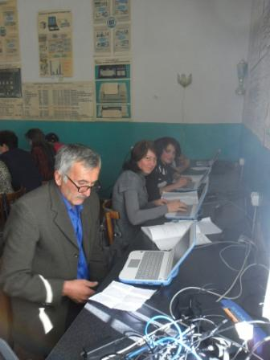
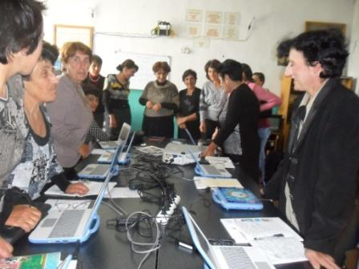
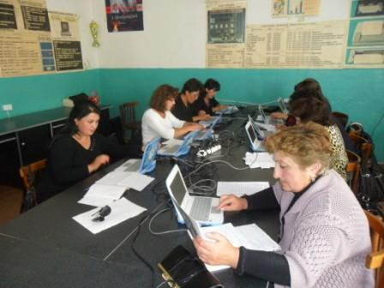
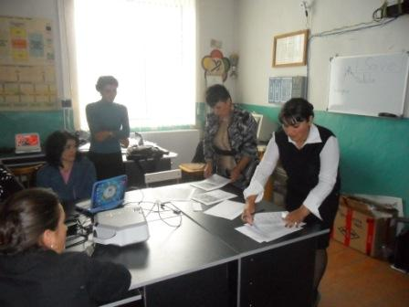
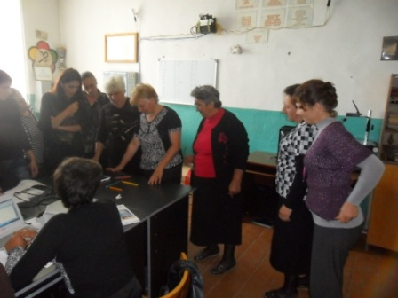
Rights and Freedoms - Union N.L.E.
Monitoring of Teacher Trainings in Georgia
Photos from trainings in Svaneti
Trainer Dmitry Popov

Slide 12
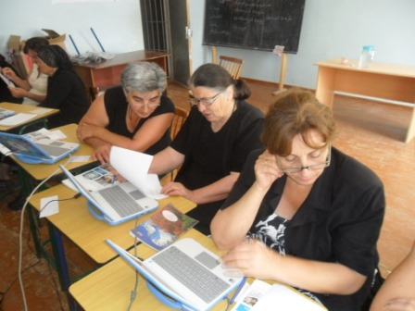
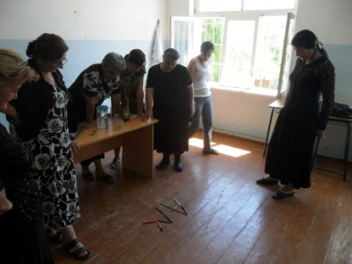
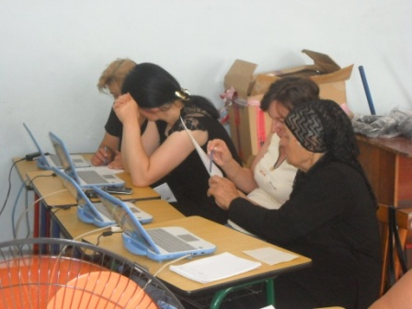
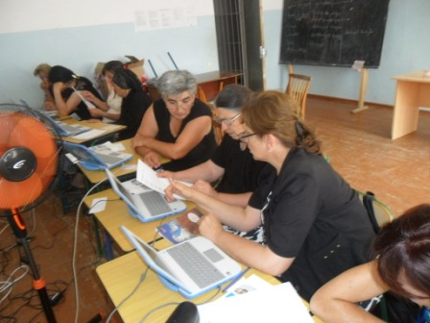
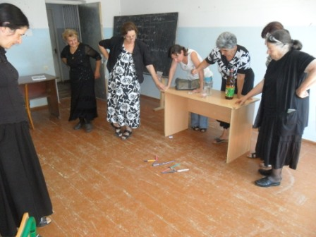
Rights and Freedoms - Union N.L.E.
Monitoring of Teacher Trainings in Georgia
Photos from trainings in Akhalqalaki, Ninotsminda
Trainer Dmitry Popov

Slide 13
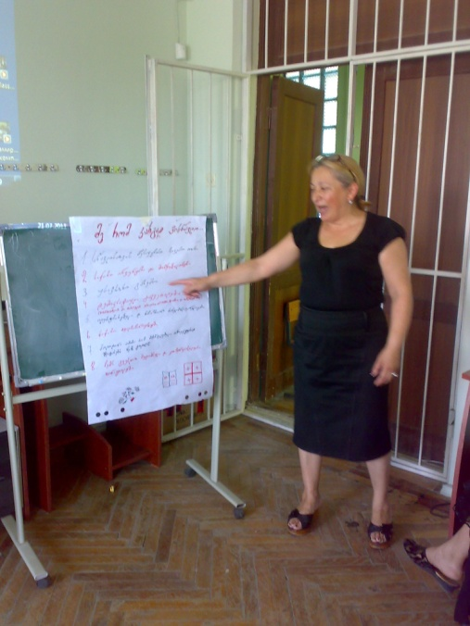
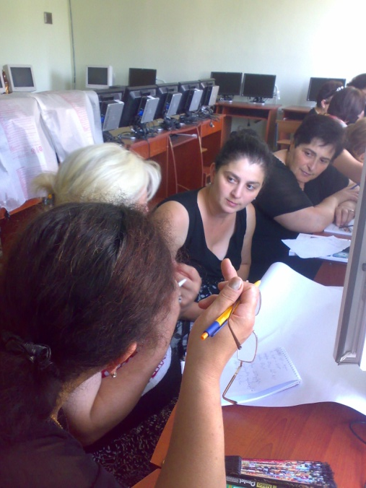
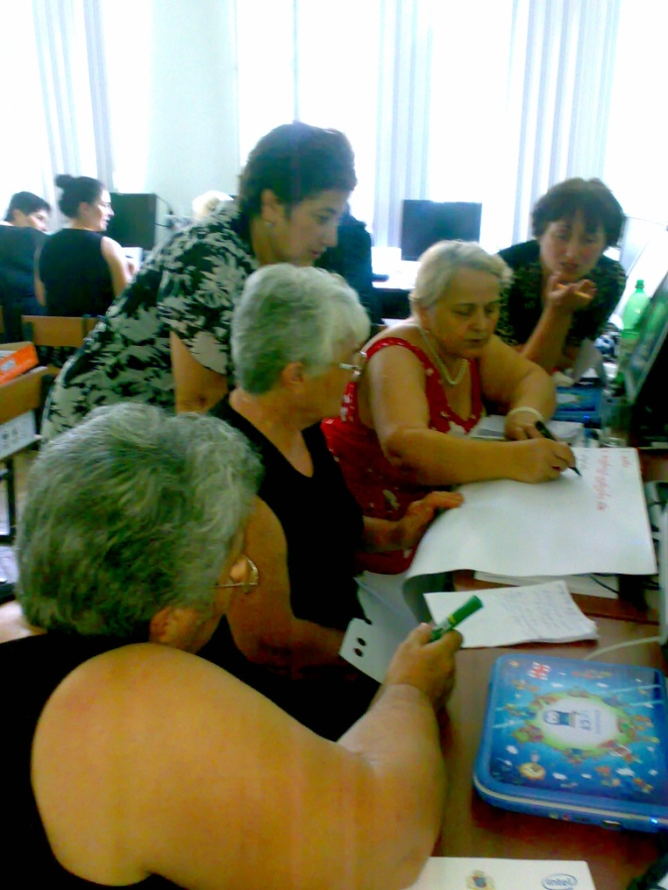
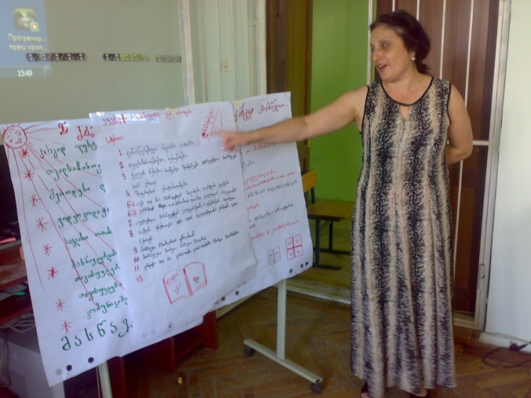
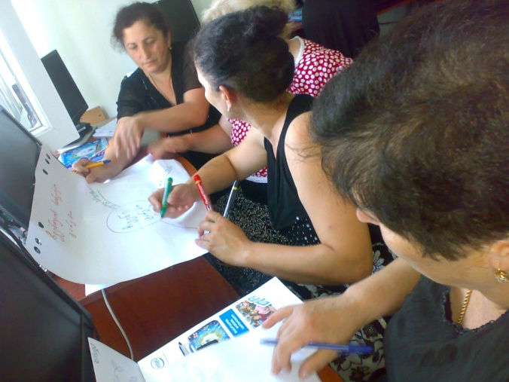
Rights and Freedoms - Union N.L.E.
Monitoring of Teacher Trainings in Georgia
Photos from trainings in Adjaria, Khelvachauri
Trainer Khatuna Lortkifanidze

Slide 14
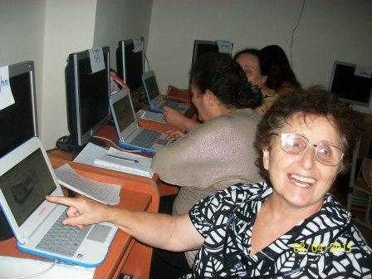
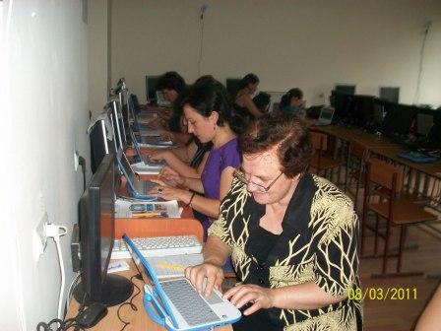
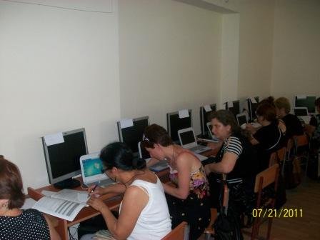
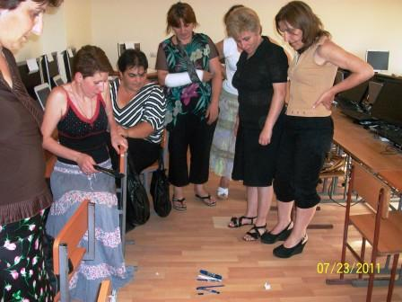
Rights and Freedoms - Union N.L.E.
Monitoring of Teacher Trainings in Georgia
Photos from trainings in Adjara, Kobuleti
Trainer Natia Tsintsadze

Slide 15
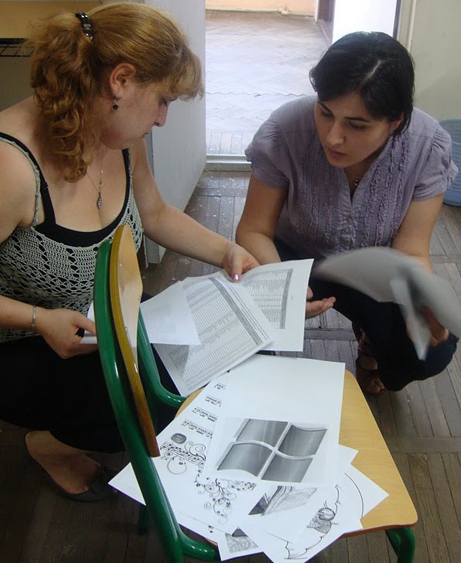
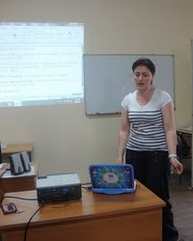
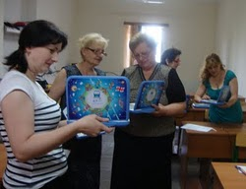
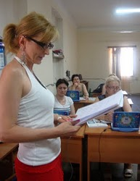
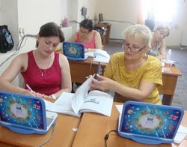
Rights and Freedoms - Union N.L.E.
Monitoring of Teacher Trainings in Georgia
Photos from trainings in Adjara, Batumi
Trainer Natia Tsintsadze

Slide 16
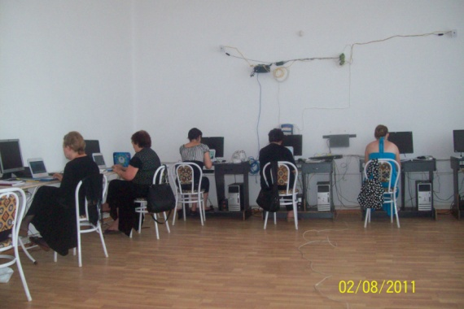
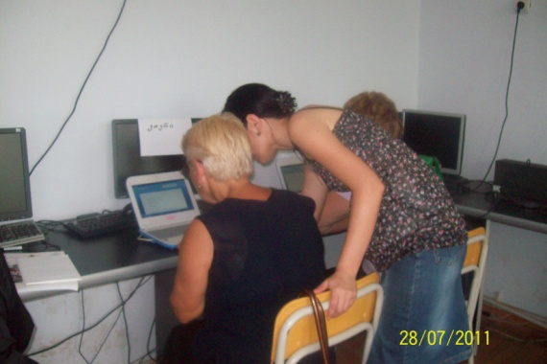
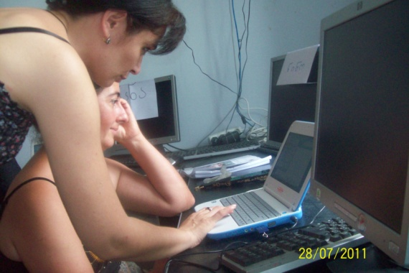
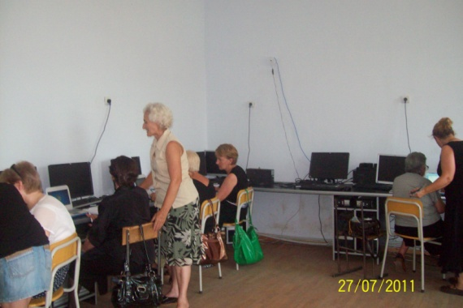
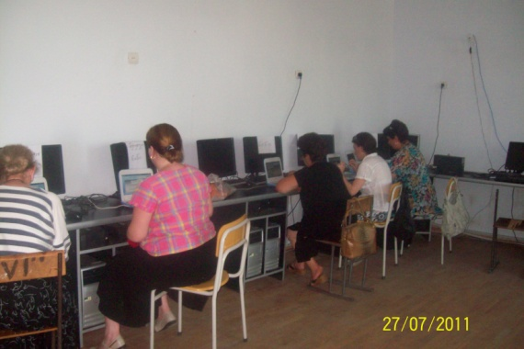
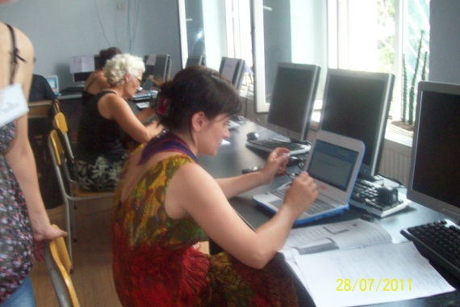
Rights and Freedoms - Union N.L.E.
Monitoring of Teacher Trainings in Georgia
Photos from trainings in Samegrelo, Poti
Trainer Eka Samursakovi

Slide 17
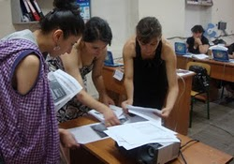
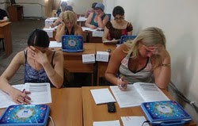
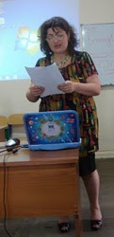
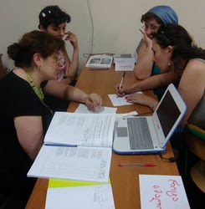
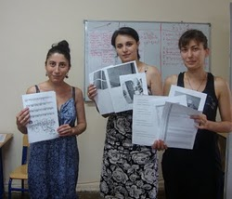
Rights and Freedoms - Union N.L.E.
Monitoring of Teacher Trainings in Georgia
Photos from trainings in Imereti, Kutaisi
Trainer Megi Kapanadze

Slide 18
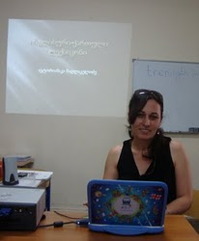
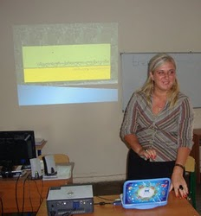
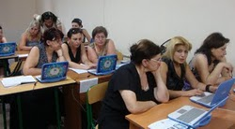
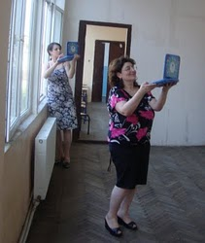
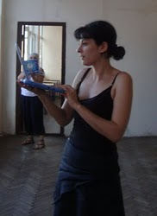
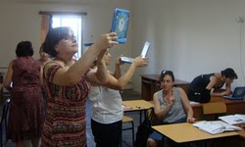
Rights and Freedoms - Union N.L.E.
Monitoring of Teacher Trainings in Georgia
Photos from trainings in Imereti, Samtredia
Trainer Mari Morchiladze

Slide 19






Rights and Freedoms - Union N.L.E.
Monitoring of Teacher Trainings in Georgia
Photos from trainings in Qartli, Khashuri
Trainer Manana Kapanadze

Slide 20





Rights and Freedoms - Union N.L.E.
Monitoring of Teacher Trainings in Georgia
Photos from trainings in Tbilisi
Trainer Diana Miqadze

Slide 21






Rights and Freedoms - Union N.L.E.
Monitoring of Teacher Trainings in Georgia
Photos from trainings in Tbilisi
Trainer Diana Miqadze

Slide 22






Rights and Freedoms - Union N.L.E.
Monitoring of Teacher Trainings in Georgia
Photos from trainings in Tbilisi
Trainer Diana Mikadze

Slide 23





Rights and Freedoms - Union N.L.E.
Monitoring of Teacher Trainings in Georgia
Photos from trainings in Tbilisi
Trainer Maia Bazgadze

Slide 24






Rights and Freedoms - Union N.L.E.
Monitoring of Teacher Trainings in Georgia
Photos from trainings in Tbilisi
Trainer Rusudan Markozashvili

Slide 25






Rights and Freedoms - Union N.L.E.
Monitoring of Teacher Trainings in Georgia
Photos from trainings in Tbilisi
Trainer Teona Lotikashvili

Slide 26
Rights and Freedoms - Union N.L.E.
Monitoring of Teacher Trainings in Georgia
Training Evaluation
Research Results
*For research of training evaluation was used Surveymonkey source: http://www.surveymonkey.net/

Slide 27
Rights and Freedoms - Union N.L.E.
Monitoring of Teacher Trainings in Georgia
Learned what I needed to know.
Answer Options | Response Percent | Response Count
Strongly Agree | 35,7% | 97
Agree | 55,9% | 152
No Opinion | 0,0% | 0
Disagree | 3,7% | 10
Strongly Disagree | 4,8% | 13
answered question |  | 272
skipped question |  | 2
Was exactly the right amount of time
Answer Options | Response Percent | Response Count
Strongly Agree | 19,3% | 52
Agree | 38,9% | 105
No Opinion | 1,5% | 4
Disagree | 27,8% | 75
Strongly Disagree | 12,6% | 34
answered question |  | 270
skipped question |  | 4
*For research of training evaluation was used Surveymonkey source: http://www.surveymonkey.net/

Slide 28
Rights and Freedoms - Union N.L.E.
Monitoring of Teacher Trainings in Georgia
Maintained an appropriate balance between lecture and hands-on activities
Answer Options | Response Percent | Response Count
Strongly Agree | 35,6% | 94
Agree | 52,7% | 139
No Opinion | 2,3% | 6
Disagree | 6,1% | 16
Strongly Disagree | 3,4% | 9
answered question |  | 264
skipped question |  | 10
Met my expectations in terms of difficulty level
Answer Options | Response Percent | Response Count
Strongly Agree | 24,5% | 65
Agree | 58,9% | 156
No Opinion | 4,5% | 12
Disagree | 9,1% | 24
Strongly Disagree | 3,0% | 8
answered question |  | 265
skipped question |  | 9
*For research of training evaluation was used Surveymonkey source: http://www.surveymonkey.net/

Slide 29
Rights and Freedoms - Union N.L.E.
Monitoring of Teacher Trainings in Georgia
Demonstrated strong knowledge of all course content
Answer Options | Response Percent | Response Count
Strongly Agree | 71,9% | 189
Agree | 25,9% | 68
No Opinion | 0,8% | 2
Disagree | 0,4% | 1
Strongly Disagree | 1,1% | 3
answered question |  | 263
skipped question |  | 11
Training was well-organized and prepared for class
Answer Options | Response Percent | Response Count
Strongly Agree | 53,0% | 141
Agree | 39,8% | 106
No Opinion | 2,3% | 6
Disagree | 3,4% | 9
Strongly Disagree | 1,5% | 4
answered question |  | 266
skipped question |  | 8
*For research of training evaluation was used Surveymonkey source: http://www.surveymonkey.net/

Slide 30
Rights and Freedoms - Union N.L.E.
Monitoring of Teacher Trainings in Georgia
Was enthusiastic and engaging
Answer Options | Response Percent | Response Count
Strongly Agree | 58,9% | 156
Agree | 38,9% | 103
No Opinion | 1,1% | 3
Disagree | 0,4% | 1
Strongly Disagree | 0,8% | 2
answered question |  | 265
skipped question |  | 9
I’d recommend this course to others
Answer Options | Response Percent | Response Count
Strongly Agree | 70,0% | 184
Agree | 27,8% | 73
No Opinion | 1,5% | 4
Disagree | 0,8% | 2
Strongly Disagree | 0,0% | 0
answered question |  | 263
skipped question |  | 11
*For research of training evaluation was used Surveymonkey source: http://www.surveymonkey.net/

Slide 31
Rights and Freedoms - Union N.L.E.
Monitoring of Teacher Trainings in Georgia
Learned methods will use in my practice work
Answer Options | Response Percent | Response Count
Strongly Agree | 65,4% | 176
Agree | 33,5% | 90
No Opinion | 0,7% | 2
Disagree | 0,0% | 0
Strongly Disagree | 0,4% | 1
answered question |  | 269
skipped question |  | 5
Would Like to get news and updates
Answer Options | Response Percent | Response Count
Strongly Agree | 79,9% | 215
Agree | 18,2% | 49
No Opinion | 0,7% | 2
Disagree | 0,7% | 2
Strongly Disagree | 0,4% | 1
answered question |  | 269
skipped question |  | 5
*For research of training evaluation was used Surveymonkey source: http://www.surveymonkey.net/

Slide 32
Rights and Freedoms - Union N.L.E.
Monitoring of Teacher Trainings in Georgia
Feedbacks from Teachers
*For research of training evaluation was used Surveymonkey source: http://www.surveymonkey.net/

Slide 33
Rights and Freedoms - Union N.L.E.
Monitoring of Teacher Trainings in Georgia
Teachers are happy that they had learned how to access Google, explore search options like Website, Pictures, Video, News, Translation, Blog, Gmail, and more now they know how to make there lessons more interesting and exiting for children.
Teachers were exited with making foreign language vocabulary.
They will use this method with pleasure, they will be working in groups to create a dictionary of English words to help other students learn new words, Students will use the technology and skills to capture a real life object and identify the different forms it contains.

Slide 34
Rights and Freedoms - Union N.L.E.
Monitoring of Teacher Trainings in Georgia
Teachers had learned how to create a classroom newsletter with help MS word. How and were to use MS office soft.
Teachers had learned how to Create Video or a Photo Slideshow.
Teachers Liked the Classroom collaboration software. They will use common functions like screen sharing, files distribution, students lists creation, surveys, remote management …
Most of the teachers like File Distribution function.
Quiz Module became one of the most LOVED modules for most of the teachers. They like that they can create and save question banks with questions of several types.
Teachers are happy that they had learned how to manage Internet Safety for Students.
Teachers were giving a big thanks for deploying such project, “this is the biggest and most important investment for our children future”.

Slide 35
Rights and Freedoms - Union N.L.E.
Monitoring of Teacher Trainings in Georgia
Thank you!
monitoring@freedom.org.ge

